Slide 1
ITC6110 – Natural Language Processing
Final Project Presentation
Presented by: Kapsalis C.
Stavrogiannis C.
Tzoras K.

Slide 2




Data Loading and Working Environment Setup
Deliberately selected various publicly available datasets from Kaggle to allow for the smooth implementation of all taught NLP techniques.
Different datasets to focus on when training models for:
Unsupervised learning
Text classification
Machine Translation
Selected datasets contained millions of text samples to produce high-quality results.
To facilitate working on a big scale:
BigQuery
Google Drive
Premium machines rented from Google

Slide 3
Text Pre-Processing - Overview & Methodology
All the samples we worked with across datasets came from tweets.
uniform pre-processing on their raw text columns
At the same time: extraction of features of linguistic interest (as in the number of Part of Speech-POS and Named Entity instances per text) to use in later operations.
Dropped specific symbols and punctuation marks not bearing contextual information, as well as stop-words (<=4 characters) and short words.
Important: Tweets typically contain informal language usage => prone to spelling errors => increased randomness => spelling error correction.

Slide 4
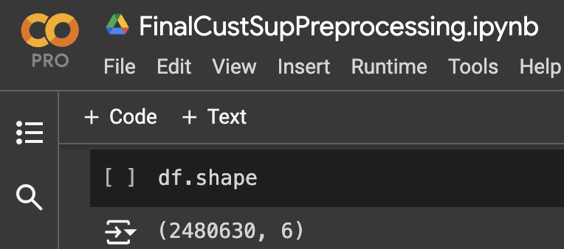

Text Pre-Processing - Methodology
This significantly increased execution times, especially in the very large scale of our operations (millions of tweets / dataset).
Parallel computing and batching as well as RegEx optimization was implemented to preserve computational resources.

Slide 5
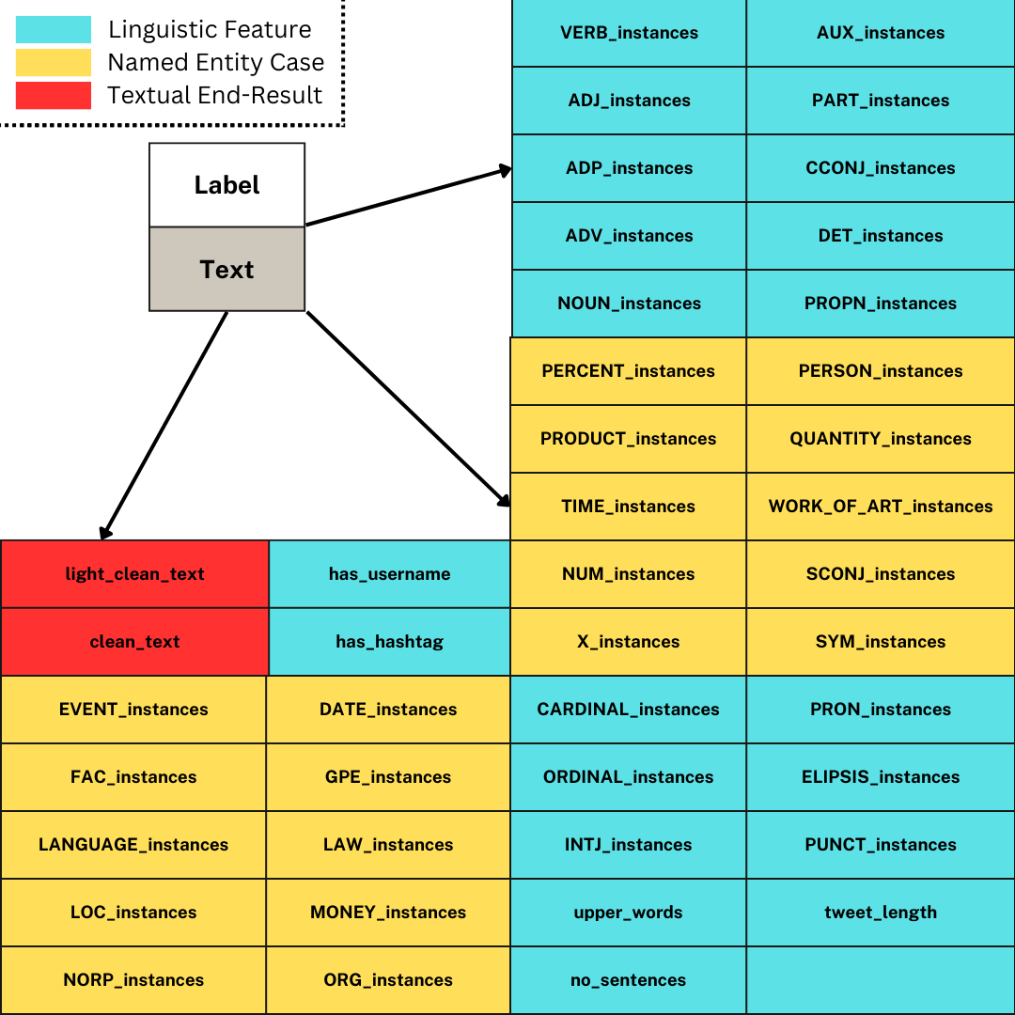
Text Pre-Processing
Results
Example of ‘(light_)clean_text’:
“Welcome to the family, Mia Meli! #new #puppy #adorable #cute #fluffy #mutt #mybaby #girl http://t.co/a27C1XueZP”
=> “welcome to the family, mia meli!”
=> “welcome the family mia meli!”

Slide 6
Unsupervised – Topic Modeling
Application of 3 distinct models (LDA, LSA, BERTopic)
Hyperparameter and tuning on each model.
Evaluate the performance & derive best model.
Insights of results.

Slide 7
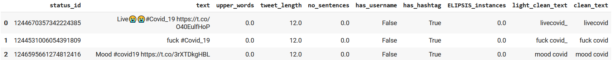
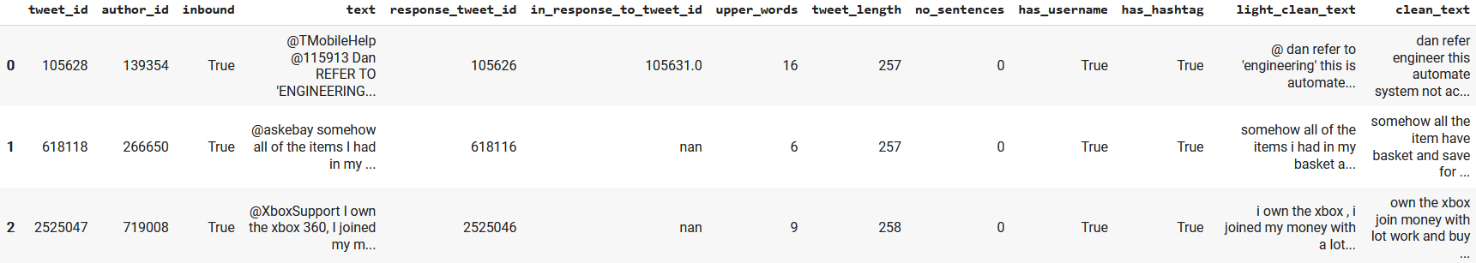
Datasets Overview
Two distinct datasets for which we followed similar approach.
Covid dataset
Customer support dataset

Slide 8


Models Applied Overview and Comparison
Pros
LSA (Latent semantic analysis)
Faster than other models we can define easily the number of topics and can provide a good initial overview of the clusters in our dataset.
LDA (Latent Dirichlet Allocation)
Produces topics which are interpretable more coherent and human-understandable.
BERTopic
Captures semantic meaning more effectively than traditional methods.
Produces more meaningful and contextually accurate topics due to the use of transformer-based embeddings (pretrained Sentence Transformer).
Cons
LSA
Our “control” model.
Inferior for results interpretation.
LDA
Computationally intensive.
BERTopic
Computationally intensive. (Not as much as LDA though)
Each one of the models used provided different results and insights thus it is important to combine more than one techniques for topic modeling and understanding.

Slide 9
Model(s) Tuning Parameters
LDA
alpha: a hyperparameter that controls the number of topics for each document.
beta: a hyperparameter that controls distribution of words per topics.
iterations: number of iterations the algorithm makes over the dataset during training.
gamma_threshold: defines the topic-change while applying topic assignment.
LSA
n_components: determines how many topics the model will identify.
top_n_words: defines the number of top words to extract and display for each topic.
BERTopic
nr_topics: specifies the number of topics to be extracted.
min_topic_size: defines the minimum size of documents required for a topic to be formed.
top_n_words: defines the number of most important words to be displayed for each topic.

Slide 10
Evaluation of Models
Comparison of Models
Aggregate results including coherence scores, perplexity and diversity metrics from LSA, BERTopic, and LDA.
Evaluation metrics
LSA: Coherence score, Diversity
LDA: Coherence score, Perplexity, Silhouette score, Davies-Bouldin index
BERTopic: Coherence score, Diversity
Used the coherent_score common amongst all models to find the best solution.
LSA constantly performed worst than BERTopic and LDA.
Interpreted results both on BERTopic and LDA best and base models.

Slide 11
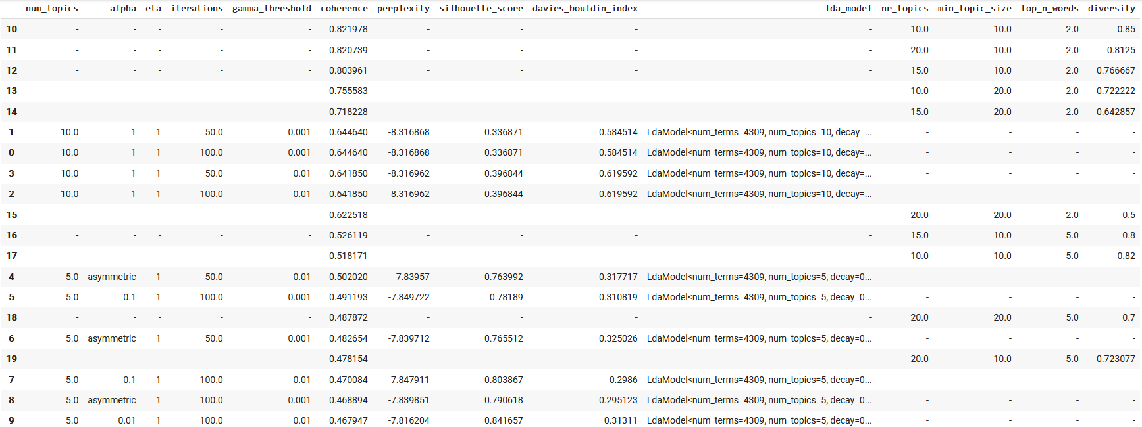
Aggregated Results – Covid Dataset

Slide 12
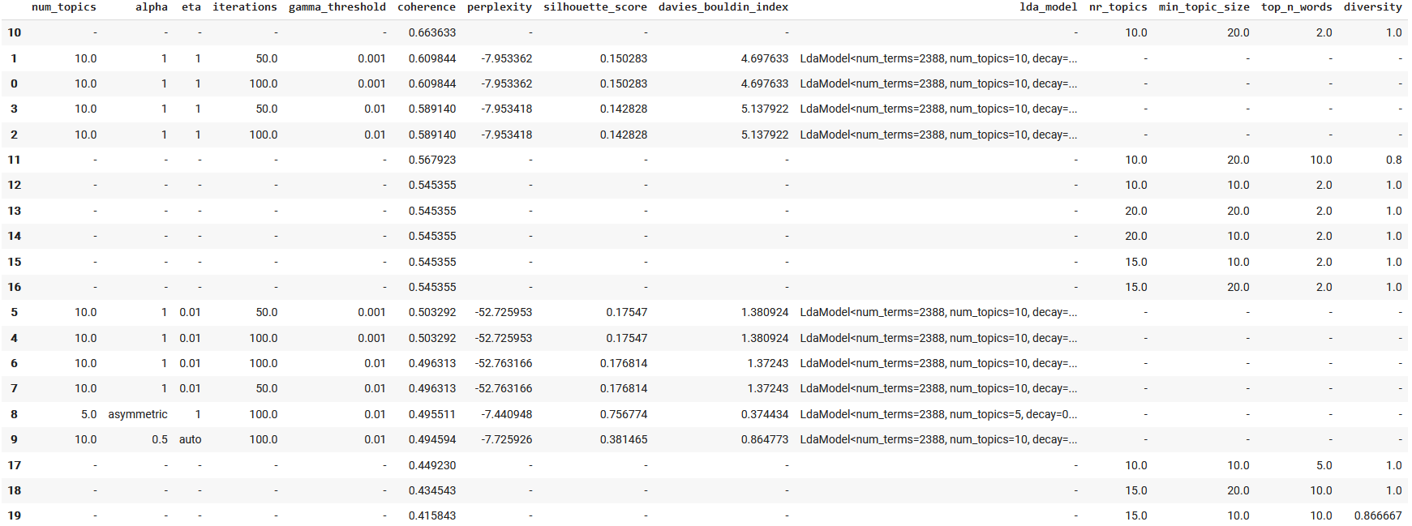
Aggregated Results – Customer Support Dataset

Slide 13
Result Analysis
LSA can quickly provide a high-level overview and is useful for getting a basic idea of our dataset(s). The results derived show constantly worst coherence irrelevantly of the tuning applied.
LDA offers interpretable topics providing clear topic-word distributions, is a great model to provide results in an understandable manner
Comparable results based on the coherence with BERTOpic
BERTopic captures better the semantic relationships and provides insights/information that might be missed by LSA and LDA.
Better coherence score than the above methods

Slide 14
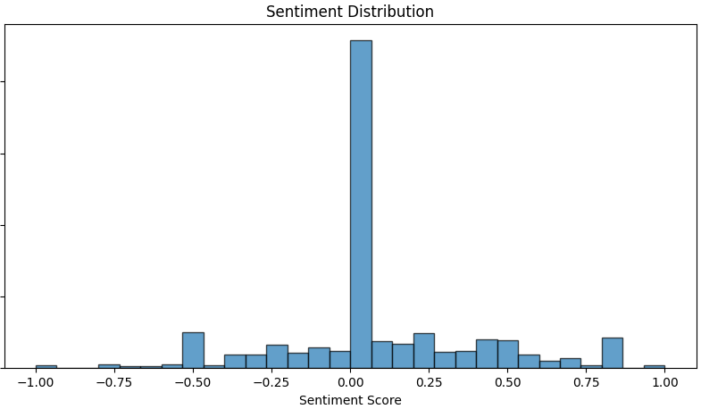
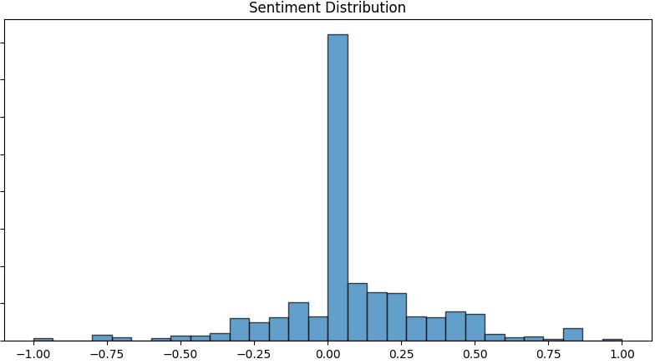
Data Analysis Overview
Customer support Case
Covid Case

Slide 15
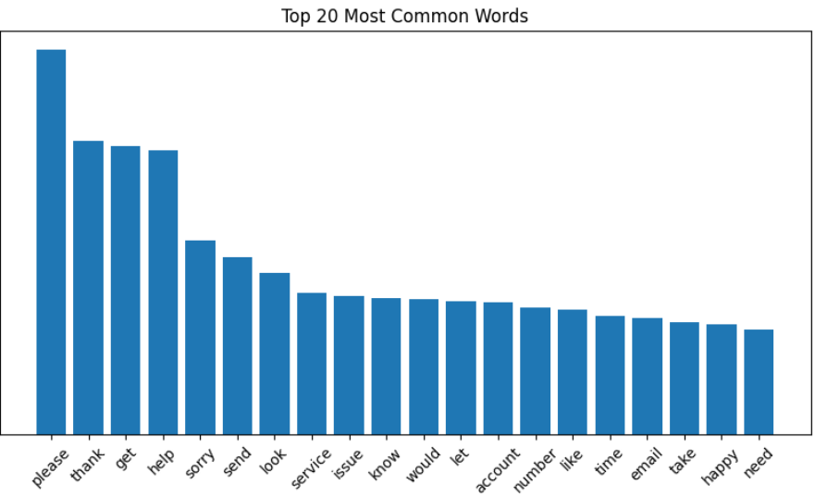
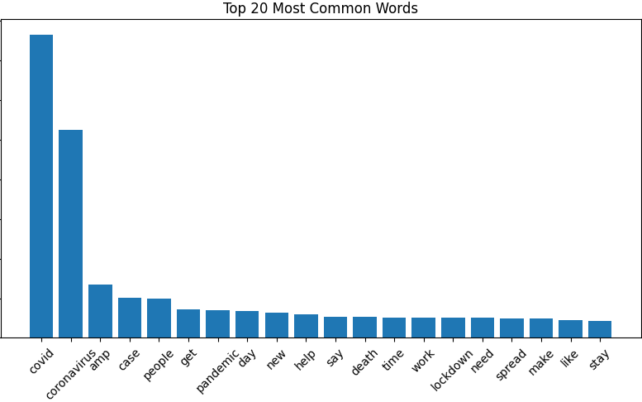
Data Analysis Overview
Customer support Case
Covid Case

Slide 16
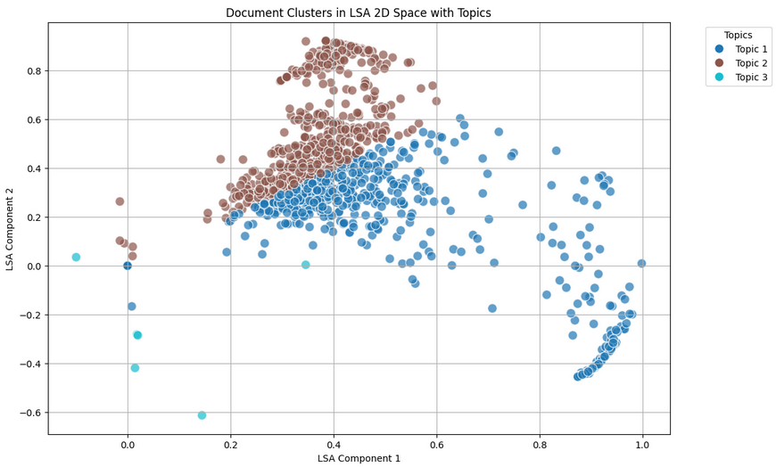
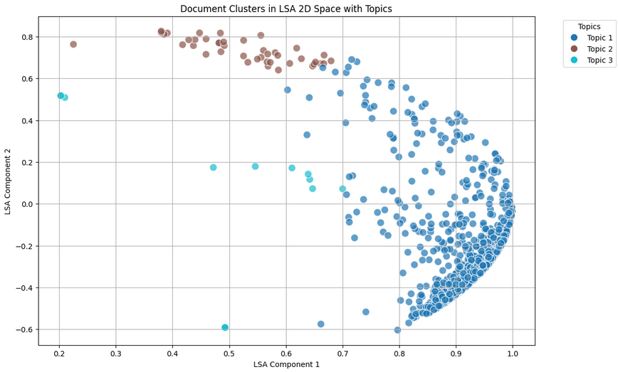
Topic Modeling (LSA)
Customer support Case
Covid Case

Slide 17
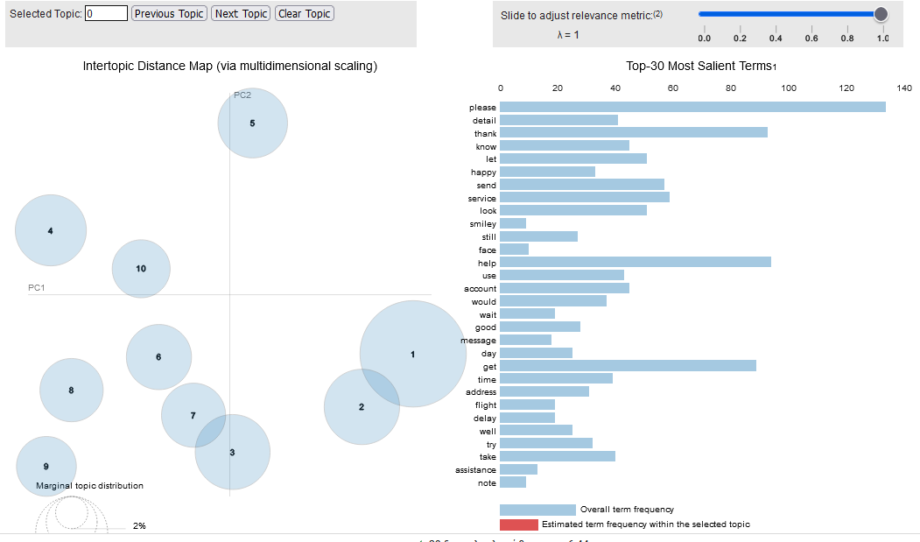
Topic Modeling (LDA) Customer Support Case

Slide 18
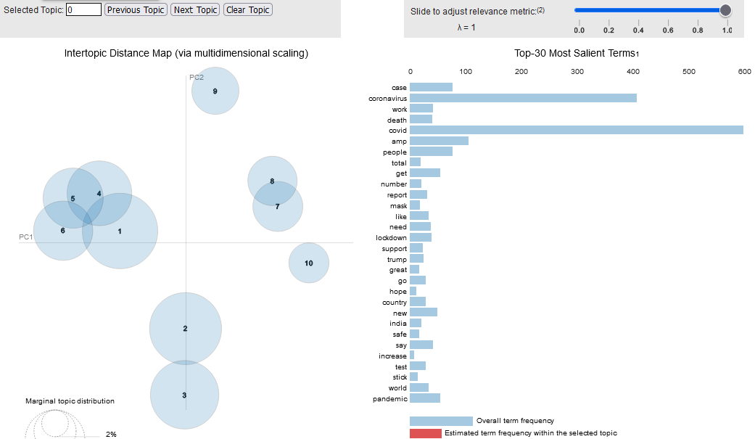
Topic Modeling (LDA) Covid Support Case

Slide 19
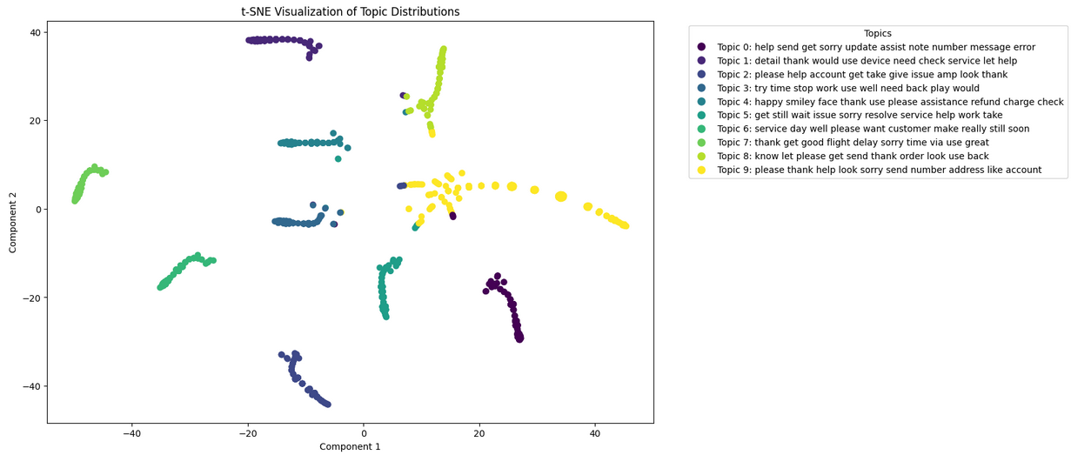
Topic Modeling (LDA)
Customer Support Case
LDA and t-SNE for dimensionality reduction

Slide 20
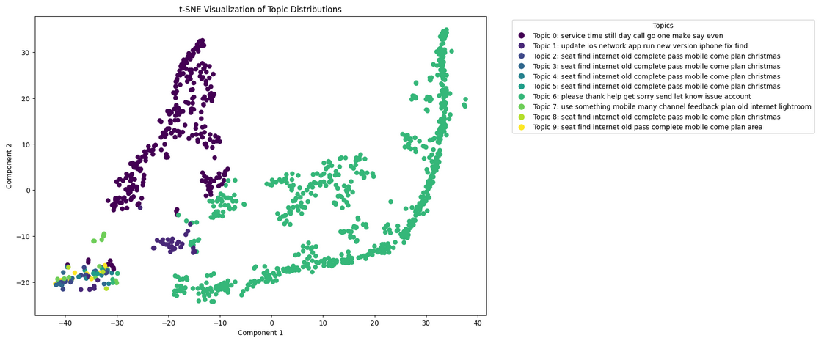
Topic Modeling (LDA)
Customer Support Case
LDA and t-SNE for dimensionality reduction

Slide 21
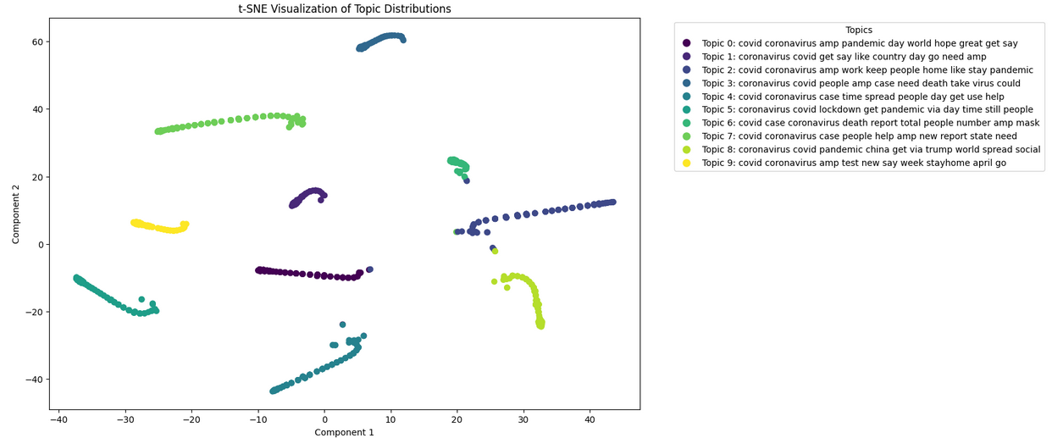
Topic Modeling (LDA)
Covid Case
LDA (best param) and t-SNE for dimensionality reduction

Slide 22
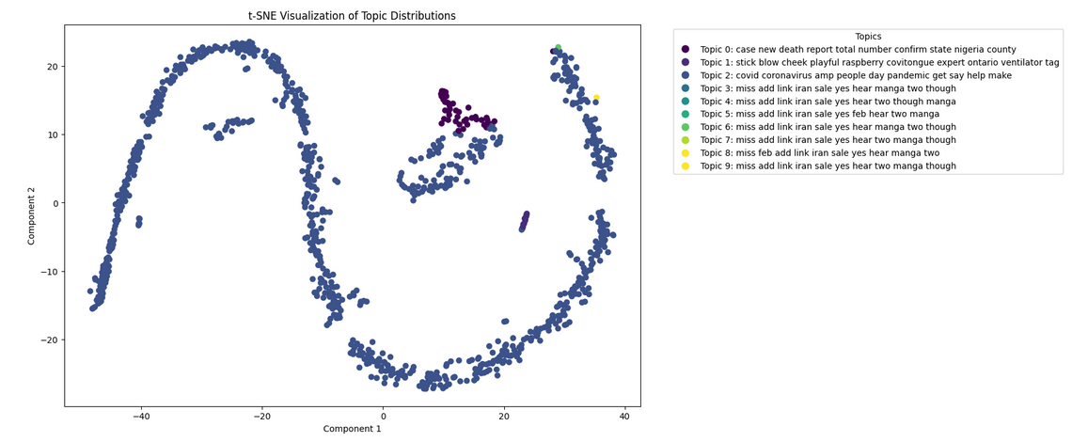
Topic Modeling (LDA)
Covid Case
LDA (best param) and t-SNE for dimensionality reduction

Slide 23
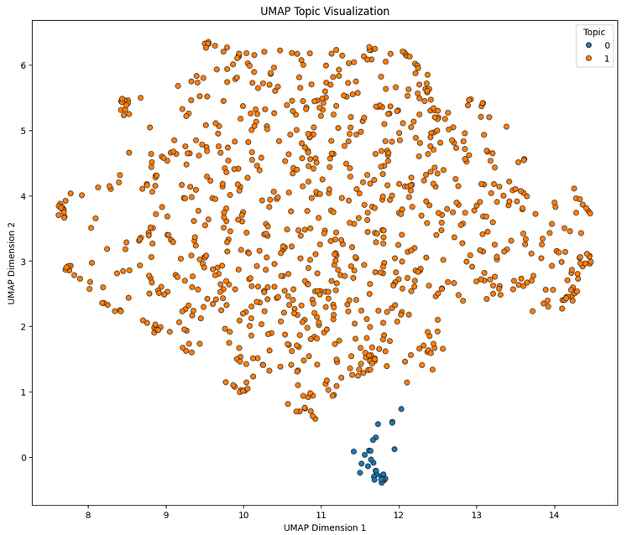
Clustering Topic Modeling (BERTopic)
Customer Support Case
BERTopic and UMAP for dimensionality reduction

Slide 24
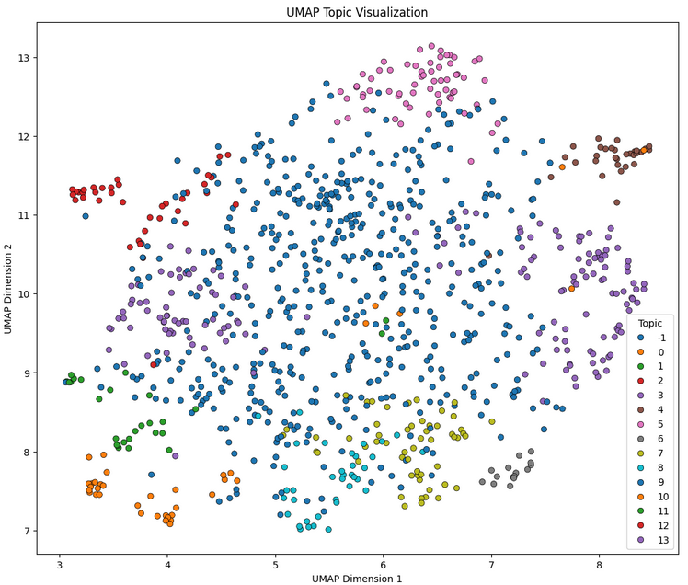
Clustering Topic Modeling (BERTopic)
Covid Case
BERTopic and UMAP for dimensionality reduction

Slide 25
Named Entity Recognition - Overview
Treated as a token classification problem.
We decided to showcase the implementation of methods spanning across the 3 most recent phases of NER research’s evolution.
Our pipeline was optimized to be applied to the ‘uns_covid1’ dataset, which contains tweets related to the recent coronavirus pandemic.
Annotation schema:
‘generic’ | ‘medical-conditions’ | ‘symptoms’ | ‘treatments’
‘organizations’ | ‘policies’ | ‘metrics’
Rules-Based Approaches
Statistical Approaches
Deep Learning-Based Approaches
Transformer Models

Slide 26


Named Entity Recognition - Creating Annotated Data
We avoided manually annotating samples so as to do it at scale based on the development of sophisticated RegEx patterns.
InstructGPT (through OpenAI’s API) helped us explore keywords.
WordNet’s “synsets” (through NLTK) helped us enrich them.
Manual inspection ensured the quality of our annotated data.
Developed function to produce the same result as the NER annotator.
Developed function to convert the previous into the .spacy format required for SpaCy model (re)training.

Slide 27
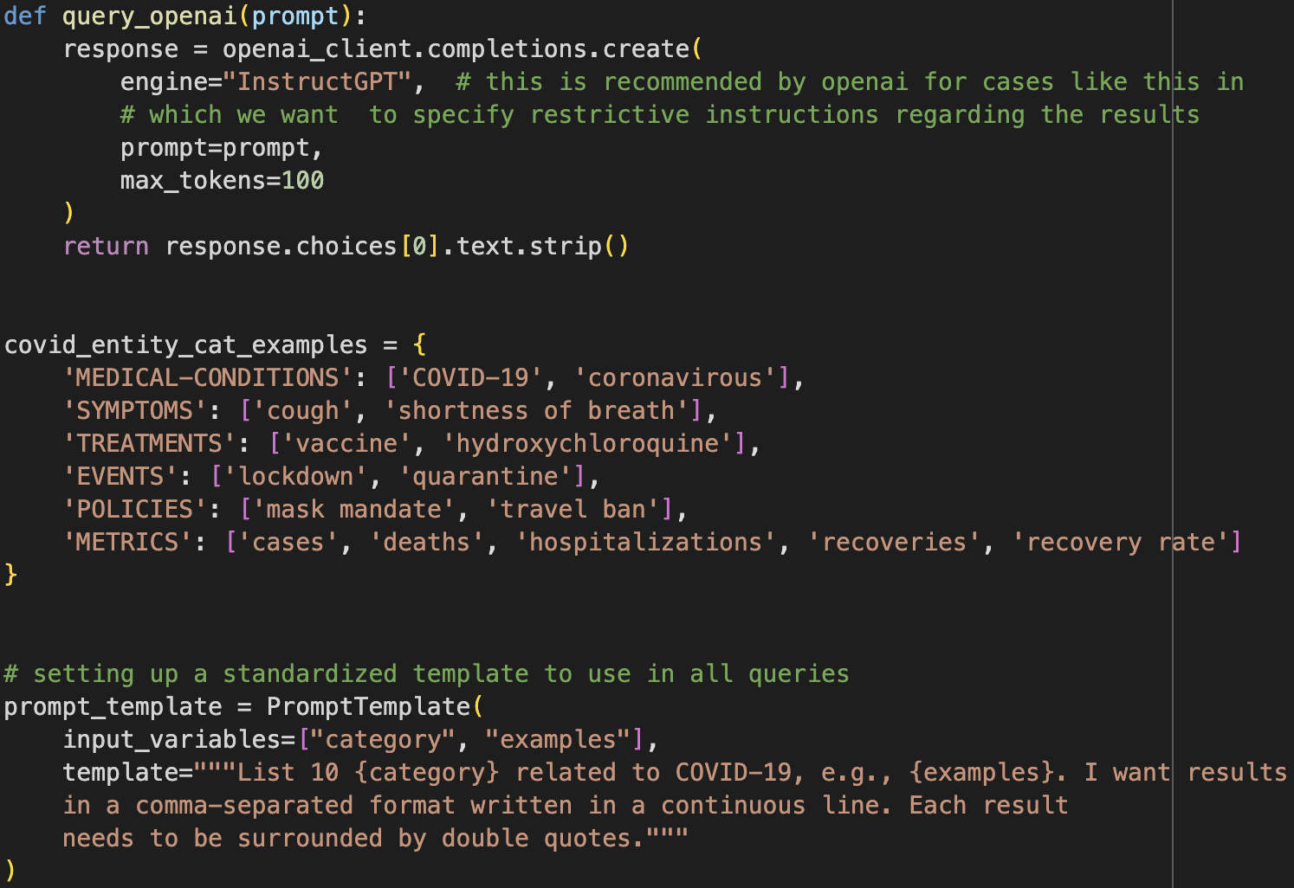
InstructGPT
Suitable for tasks which demand the adherence to strict rules (either for the nature of the results or their presentation).

Slide 28
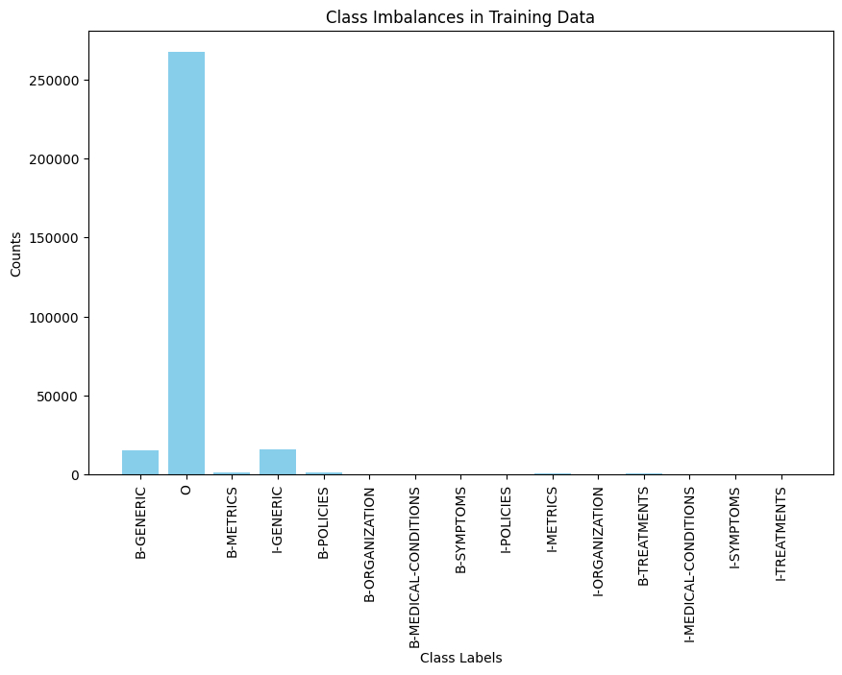
Important Note
Significant ‘class’ imbalances do exist. However, we chose not to address them except for minor steps of precaution in the case of statistical NER.
Selective undersampling cannot be an option under conditions of:
limited human resources are available
avoiding mislabelling is of paramount importance
Low-resource languages where there is no sufficient number of available training samples
… which represent most actual research cases => interesting to compare models’ performance in such a setting (500 unbalanced samples)

Slide 29



Named Entity Recognition - Maximum Entropy Model
Based on scikit-learn’s ‘LogisticRegression’ class.
Model input: not just information on the surrounding tokens, but also on other features we might have extracted (e.g. POS-related)
We only take into account the NER labels of surrounding tokens to match the settings of later models.
The weights on features are applied based on the estimation of a probability distribution aligning with the Maximum Likelihood distribution.
Makes no overt assumptions on the training set - less prone to overfitting

Slide 30
Named Entity Recognition - Transformer-Based NER
Based on (re)training of SpaCy models utilizing the ‘transformers’ architecture.
Optimization for CPU or GPU execution
Improvising on the pre-trained vectors of ‘en_core_web_sm’ to avoid long execution time.
Highly-customizable architecture options based on
Focus on accuracy or efficiency
Retraining an existing SpaCy model or training a model from scratch.

Slide 31

Named Entity Recognition - LLM-Based NER
We implemented a PromptNER algorithm based on its foundational paper.
Underlying LLM utilized: DistilBERT (computationally efficient alternative implementation of BERT)

Slide 32
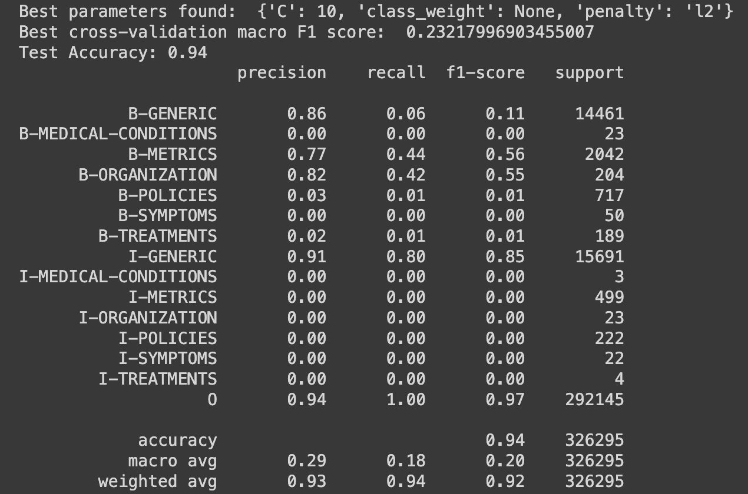
Named Entity Recognition - Results: Maximum Entropy
Very bad performance on
the under-represented classes.
It fell victim to the severe
class imbalances.

Slide 33
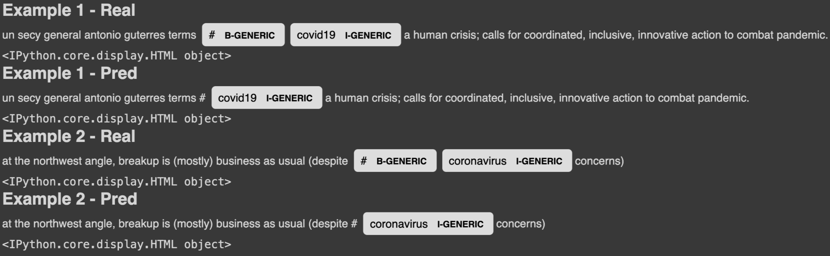
Named Entity Recognition - Results: Maximum Entropy
We observed that hashtags were used before ‘generic’ covid-related terms either by news organizations or by people that just wanted their tweets to show on others’ feeds.
We retained them since they denote a different use of such generic terms, and we wanted to try and get the model capture this contextual difference.
This model didn’t do so (macro avg f1 score of 0.11 in ‘B-GENERIC’); transformers-based did.

Slide 34
Named Entity Recognition - Results: SpaCy
Optimal SpaCy model: base_config_en_gpu_accuracy_null.cfg
training_n | 500
overall_precision | 0.96
overall_recall | 1.00
overall_f1 | 0.98
The model performing the best on a Google-rented TPU was the:
gpu-optimized
focused on prediction accuracy and
taking no default spacy model into account.
Good performance even in under-represented classes, and with limited training time and data.
=> true to the promises of the attention mechanism
Label | prec | rec | F1
GENERIC | 0.99 | 1 | 0.99
METRICS | 0.96 | 1 | 0.98
TREATMENTS | 1 | 1 | 1
MEDICAL-CONDITIONS | 1 | 1 | 1
ORGANIZATION | 0.95 | 1 | 0.98
POLICIES | 0.85 | 1 | 0.92
SYMPTOMS | 1 | 1 | 1

Slide 35




Named Entity Recognition - Results: SpaCy
Not a very good job at ‘metrics’ cases; very mixed training annotations between containing numbers and not, so most of the times it captured just ‘cases/patients/…’.
Should have only considered cases of “(number) cases/deaths/patients“ in the underlying annotation patterns.

Slide 36
Named Entity Recognition - Results: PromptNER
With 3 few-shot examples, our PromptNER model failed to produce any annotations.
Metric | precision | recall | f1 | support
CONDITIONS | 0 | 0 | 0 | 2
GENERIC | 0 | 0 | 0 | 113
METRICS | 0 | 0 | 0 | 12
POLICIES | 0 | 0 | 0 | 10
TREATMENTS | 0 | 0 | 0 | 1
SYMPTOMS | 0 | 0 | 0 | 5
across_prec | 0 | 0 | 0 | 0
across_rec | 0 | 0 | 0 | 0
across_f1 | 0 | 0 | 0 | 0
across_acc | 0.9 | 0.9 | 0.9 | 0.9
We could try refining our prompt and/or consider alternative underlying LLMs.

Slide 37
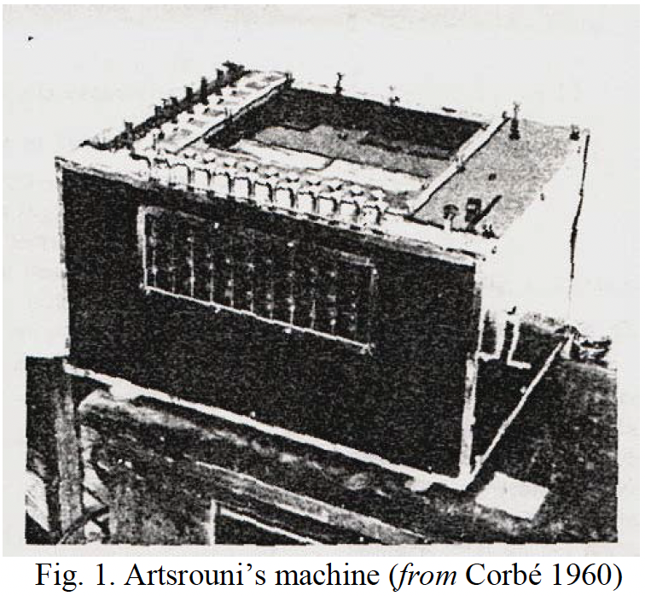
Machine Translation - Overview
One of the most technically and theoretically demanding fields of ML.
Seq2Seq Learning
with Neural Networks (Sutskever et al., 2007)
GPT-3 is released
1999
2017
1933
2007
2020
Maximum Entropy Model (Borthwick Α., 1999)
“Attention is All you Need” (Vaswani et al., 2017)
Rules-Based Approaches
Statistical Approaches
Deep Learning-Based Approaches
Transformer Models

Slide 38
Machine Translation - Methodology
We followed two different approaches to showcase the implementation of methods that are part of MT’s most recent phases.
On any case, we implemented minimal text preprocessing (lower-casing & URL removal).
The same 5,000-words long vocabulary limit was imposed across models.
Neural Machine Translation
Seq2Seq Models without an Attention Mechanism (trained from scratch)
Pre-trained Transformer-based Models (Google’s T5, retrained)

Slide 39
Seq2Seq Learning with NNs - Setup
GRU units for efficiency - 256 in number to create enough depth for performance improvement effects
Embeddings dimension (encoding of input-output sequences): 256 - moderate enough complexity without damaging performance prospects
‘Softmax’ activation
Early Stopping & Lasso/L1 Regularization
… 25,474,404 trainable parameters
Input sequence
Output sequence
Optimizer: Adam - suggested as the default optimizer to try
Loss Function: Sparse Categorical Cross Entropy

Slide 40



Google’s Text-to-Text-Transfer-Transformer
SOTA pretrained encoder-decoder transformer model.
Promises excellent results after retraining on case-specific environments even with limited resources available - NER applications typically tick on this box
Architecture is concentrated on transfer learning cases.

Slide 41



Model Evaluation
Based on the Bilingual Evaluation Understudy (BLEU) metric.
Reference translations drawn from the high-quality WMT 2014 English-German dataset.
Maximum clipped n-gram precision rank of 4 as in the original paper.
Evaluation of the models on the very same samples.

Slide 42
Machine Translation - Results
Model | n_retrain | BLEU Score WMT 2014 references)
Seq2Seq (no attention mechanism) | 50,000 | 0.0003
T5 - no retraining | - | 0.09
T5 - after retraining | 50,000 | 0.08
Vast increase in performance with the T5 model even with shorter (re)training time.
T5’s performance drops against translating WMT 2014 references after retraining, but only 3 epochs were allowed to complete.

Slide 43
Machine Translation - Example on ‘uns_covid_1’ dataset
 | Input & Reference Translations
Input Text | Guyana: Aviation authority extends suspension of all incoming international flights until 1 May because of #COVID19
Reference Translation (DeepL) | Guyana : Luftfahrt Behörde erweitert Aufhängung von alle eingehend international Flüge bis 1 Mai denn von # COVID19
Seq2Seq (no attention mechanism) | lamp along Wear veche 0,00 the org improvement clip fizice hier anunțat cloud Autumn -22 Hosting call HY hottest pfel utilis
T5 - after retraining | bahnhof hat die flottenangehörigkeit der frankreich
 | Input & Reference Translations
Input Text | Canada: #AirCanada suspends flights to, from several airports in country because of #COVID19
Reference Translation (DeepL) | Kanada : # AirCanada setzt aus. Flüge zu , von mehrere Flughäfen in Land denn von # COVID19
Seq2Seq (no attention mechanism) | 8.0 cookbook ignored plane tradition 1980 registering intermediu warmth black complie eröffnet Germany i Right calitatea exprimat scuz entertained dite Kuwait
T5 - after retraining | kanada: aufgrund der #COVID19-flüchtling

Slide 44




Classification – Setting the stage
Vectorizers
Count
Tf-Idf
FastText
Classifiers
Logistic Regression
Support Vector Machine
Bagging
Random Forest
Gradient Boosting
Preprocessing
Raw Text
Lightly Clean Text
Clean Text
Features
All Features
Only Text
Number of Iterations: 3 x 5 x 3 x 2 = 90

Slide 45
Classification – Setting the stage
Grid-Search Parameter Ranges
Count
3 x 4 x 3 x 2 x 3 = 216 Iterations
Tf-Idf
3 x 4 x 3 x 2 x 3 = 216 Iterations
Logistic Regression
5 x 3 x 3 = 45 Iterations
Support Vector Machine
5 x 3 x 3 = 45 Iterations
Bagging
4 x 4 x 3 = 48 Iterations
Random Forest
4 x 4 x 4 x 4 = 256 Iterations
Gradient Boosting
4 x 4 x 4 x 4 = 256 Iterations
Total Iterations
90 x 1082 x 2
194,760

Slide 46
Classification – Tuning
Tuning Phase 1
Find Classifier - Vectorizer
Small parameter grids or Default parameters
Small training - validation set
Tuning Phase 2
Find Optimal Hyperparameters
Large parameter grid
Larger training - validation set
Tuning Phase 3
Feature Selection
Optimal hyperparameters
Large training - validation set

Slide 47
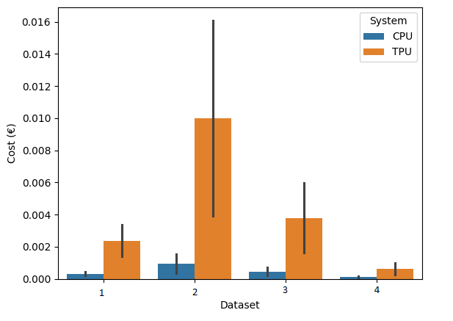
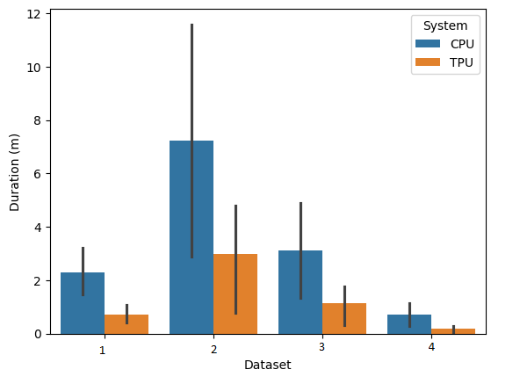
Classification – Systems

Slide 48
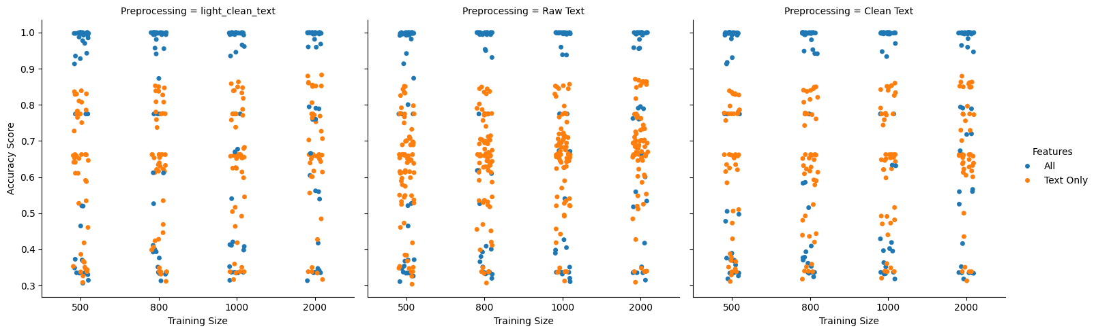
Classification – Tuning Results

Slide 49
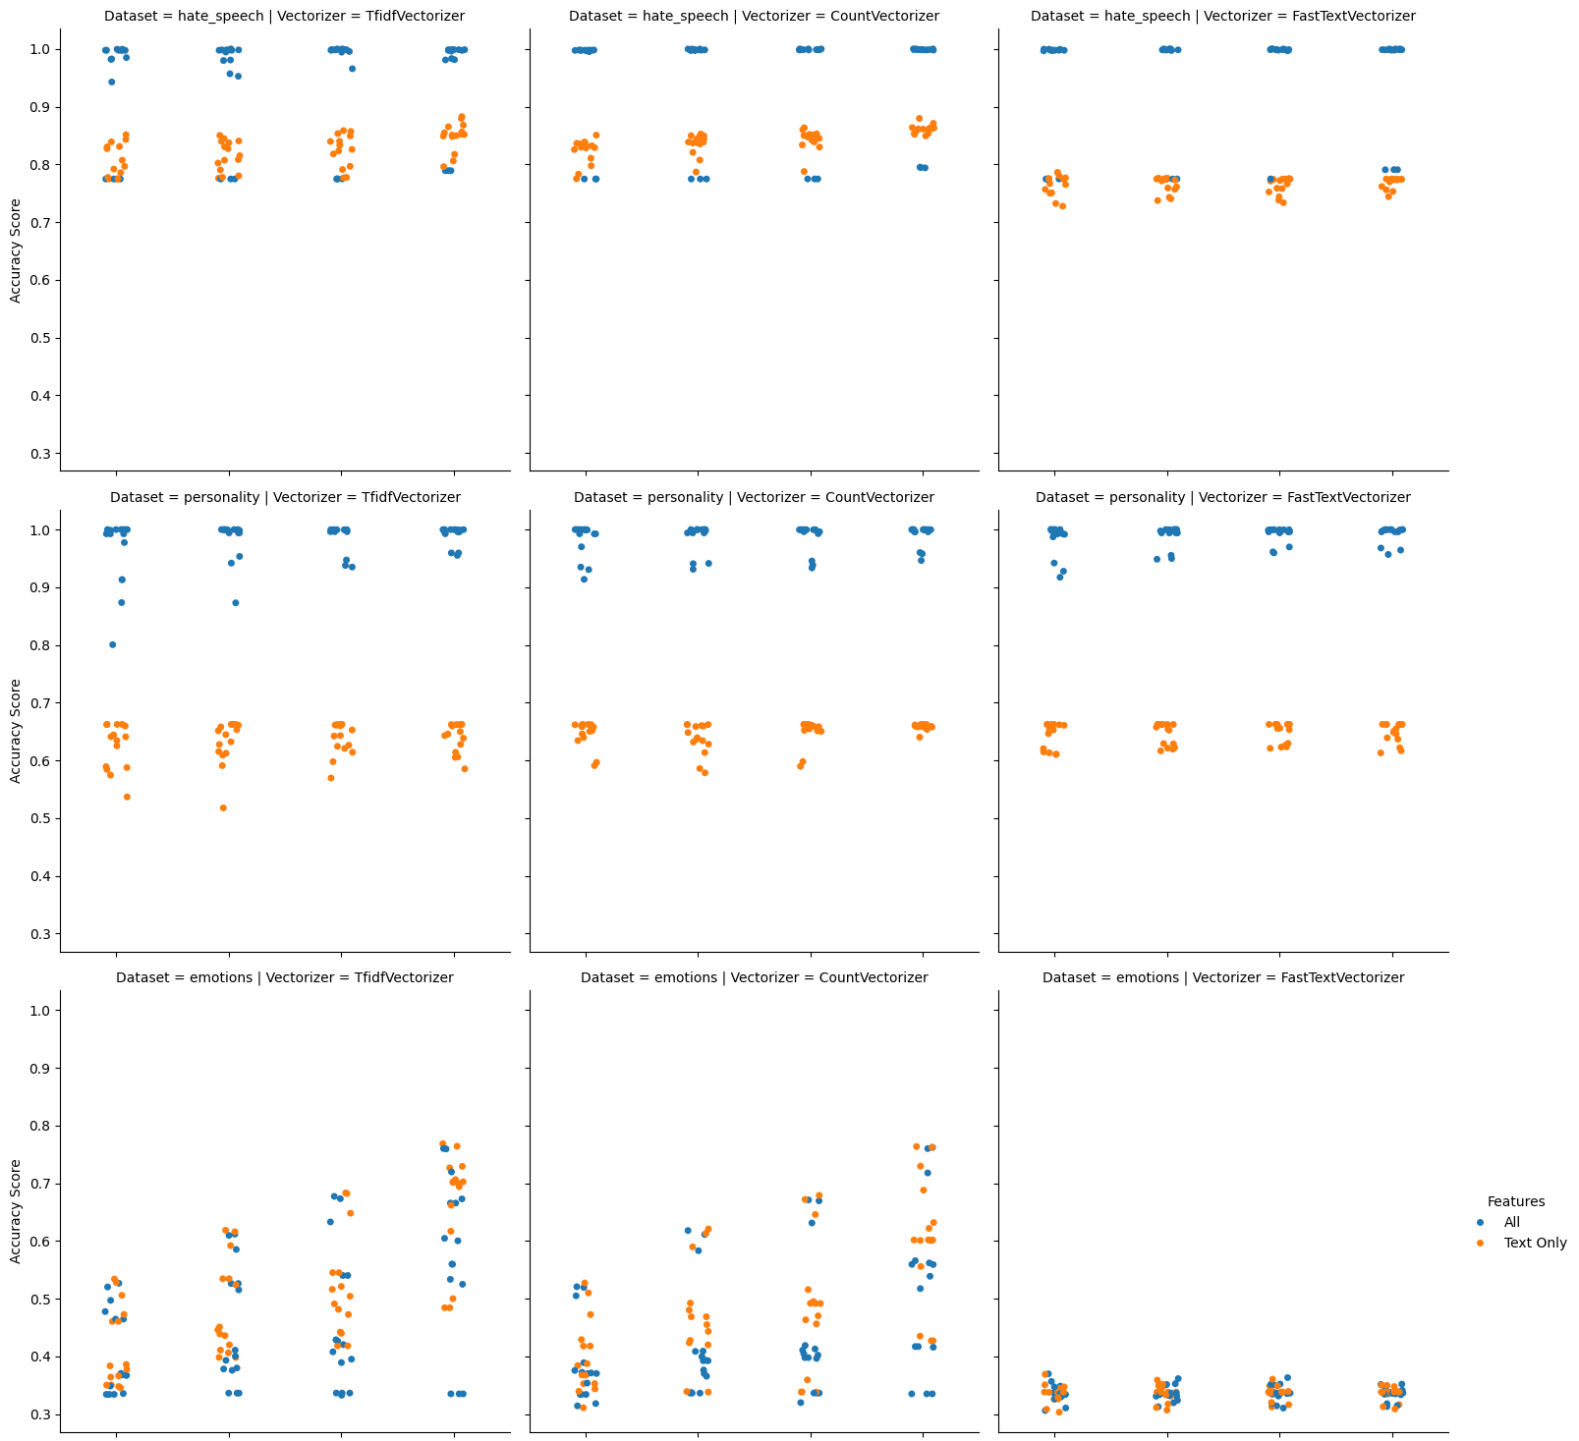
Classification – Tuning Results

Slide 50
Classification Tuning Results
hate_speech
Vectorizer Features Preprocessing Accuracy Duration (s)
CountVectorizer All Clean 1.0 0.6
CountVectorizer All light_clean_text 1.0 0.8
TfidfVectorizer All Clean 1.0 1.3
personality
Vectorizer Features Preprocessing Accuracy Duration (s)
CountVectorizer All light_clean_text 1.0 14.3
CountVectorizer All Clean 1.0 14.4
CountVectorizer All Clean 1.0 14.5
emotions
Vectorizer Features Preprocessing Accuracy Duration (s)
TfidfVectorizer Text light_clean_text 0.7687 18.8
TfidfVectorizer Text Raw Text 0.7642 18.8
CountVectorizer Text light_clean_text 0.7637 25.6
botting
Vectorizer Features Preprocessing Accuracy Duration (s)
TfidfVectorizer Text Default 0.7338 31.1
CountVectorizer Text Default 0.7335 22.2
CountVectorizer Text Default 0.7329 25.8
sentiment
Vectorizer Features Preprocessing Accuracy Duration (s)
TfidfVectorizer Text Default 0.7015 461.9
CountVectorizer Text Default 0.7013 28.1
TfidfVectorizer Text Default 0.6871 30.2

Slide 51
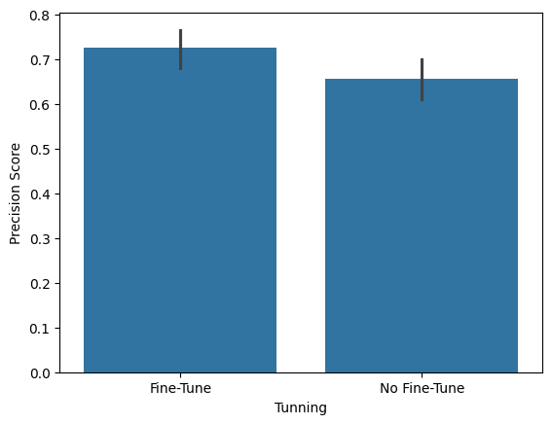
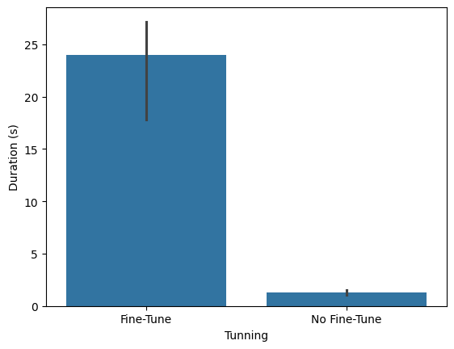
Classification – BERT pretrained

Slide 52
Classification – Final Model Results
Dataset | Preprocessing | Features | Vectorizer | Classifier | Duration (s) | Peak Memory (GB) | Accuracy Score | F1 Score | Precision Score | Recall Score
hate_speech | clean_text | All | CountVectorizer | LogisticRegression | 1.8 | 8.24 | 1 | 1 | 1 | 1
Emotions | light_clean_text | Text Only | TfidfVectorizer | GradientBoosting | 61.0 | 8.41 | 0.8474 | 0.8478 | 0.8651 | 0.8474
personality | light_clean_text | All | CountVectorizer | SVC | 27.6 | 8.95 | 0.9999 | 0.9999 | 0.9999 | 0.9999
botting | text | Text Only | TfidfVectorizer | LogisticRegression | 24.7 | 10.15 | 0.7845 | 0.7757 | 0.7760 | 0.7845
sentiment | text | Text Only | TfidfVectorizer | LogisticRegression | 99.8 | 11.63 | 0.7955 | 0.7955 | 0.7957 | 0.7955

Slide 53
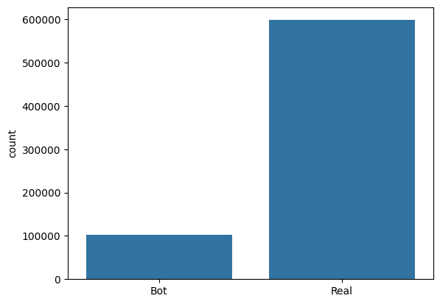
Classification – Applying to Unknown
Botting Classifier
~ 80% Accuracy
Covid Tweets
Raw Tweets

Slide 54
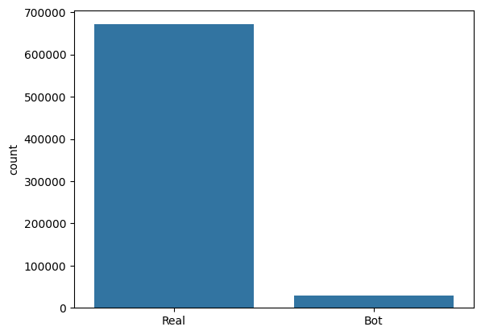
Classification – Applying to Unknown
Botting Classifier
~ 80% Accuracy
Covid Tweets
Preprocessed Tweets

Slide 55
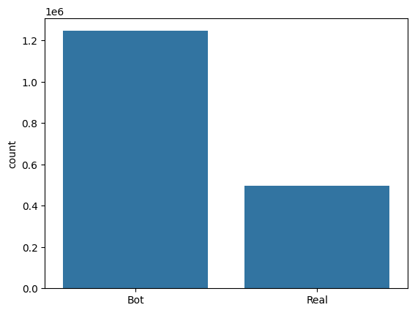
Classification – Applying to Unknown
Botting Classifier
~ 80% Accuracy
Ukraine War Tweets

Slide 56
Thank you!

